Slide 1

Robotics
Introduction to Arduino

Slide 2
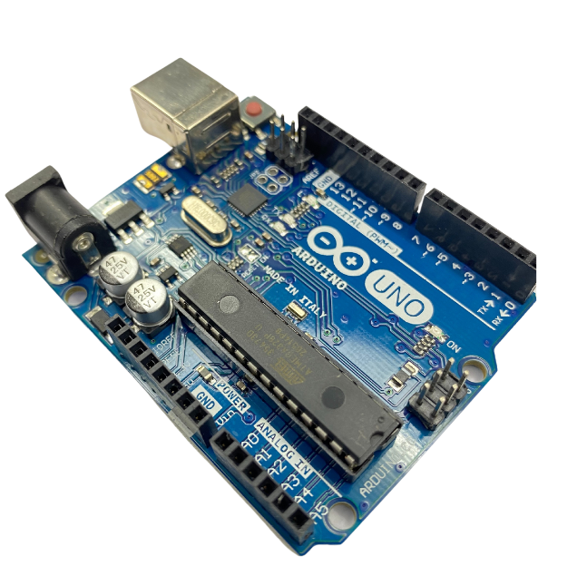
What is Arduino?
Arduino is a Electronic prototype platform (open-source) based on an easy-to-use hardware and software.
It consists of a circuit board, which can be programmed.

Slide 3
Key Features
Arduino boards are able to read analog or digital input signals from different sensors and turn it into an output such as activating a motor, turning LED on/off, etc.
Arduino IDE uses a simplified version of C++, making it easier to learn to program.
Arduino does not need an extra piece of hardware (called a programmer) in order to load a new code onto the board. You can simply use a USB cable.

Slide 4
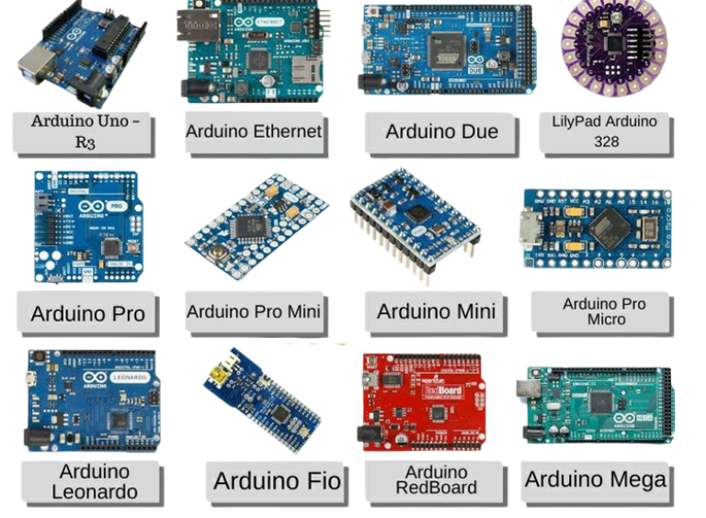
Board Types
Various kinds of Arduino boards are available depending on different microcontrollers used.
However, We will study the Arduino UNO board because it is the most popular board in the Arduino board family.

Slide 5
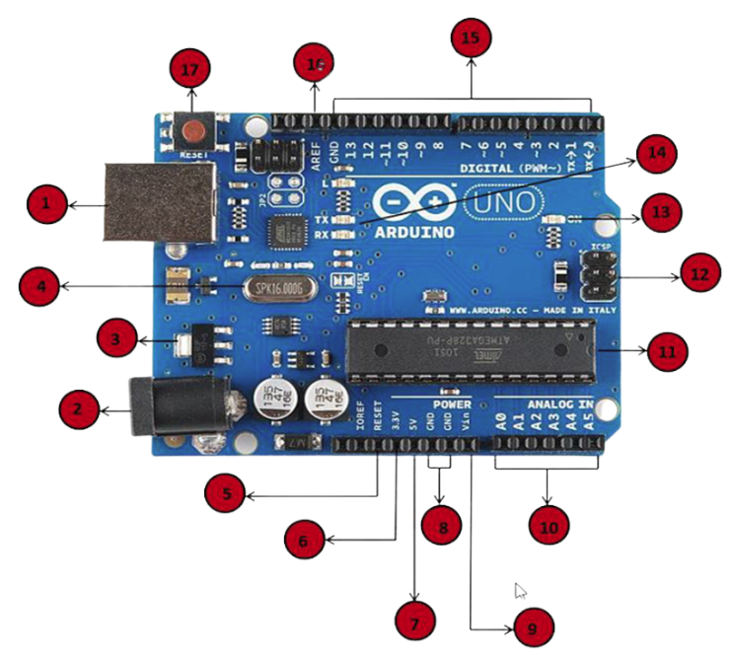
Board Description
Power USB
Power (Barrel Jack)
Voltage Regulator
Crystal Oscillator
5.17. Arduino Reset
6.7.8.9. Pins (3.3, 5, GND, Vin)
10. Analog pins
11. Main microcontroller
13. Power LED indicator
14. TX and RX LEDs
15. Digital I/O

Slide 6
Software Download
Click on the following link/Copy paste the link on the browser to download the software:
https://www.arduino.cc/en/software
It runs on Windows, Mac OS X, and Linux.
Click on the link in the column on the left that matches up with your operating system and follow the instructions to install the software

Slide 7
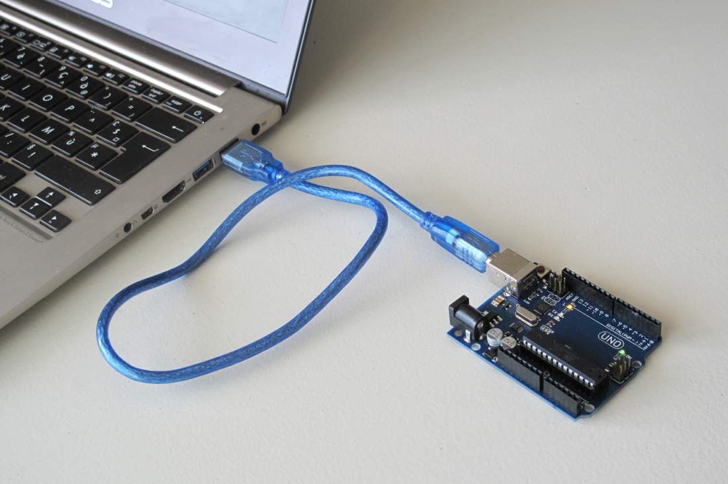
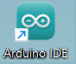
Once installation is done then connect Arduino Board to the laptop/PC using USB Cable.
You will notice that the Power LED will Glow, Wait for Windows to begin it's driver installation process.
Double click on shortcut on the Desktop to start the Software.

Slide 8
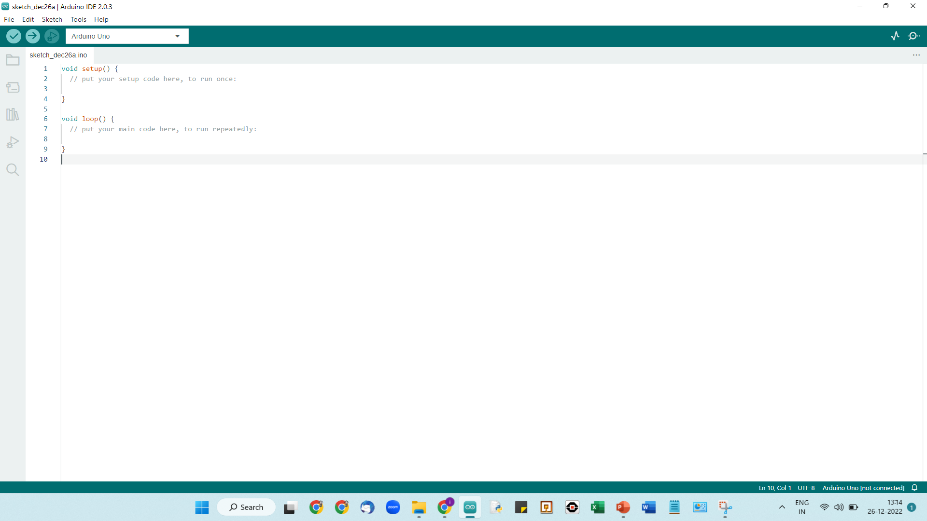
Startup / Work Screen

Slide 9
Programming
Sketch − The first new terminology is the Arduino program called “sketch”.
Structure:
setup() : The setup() function is called when a sketch starts. Use it to initialize the variables, pin modes, start using libraries, etc. The setup function will only run once, after each power up or reset of the Arduino board.
loop() : The Code written inside the loop() function will get executed again and again. It is used to actively control the Arduino board.

Slide 10
Software
A ready-made software called Arduino IDE (Integrated Development Environment) is used to write and upload the computer code to the physical board.
Program written in Arduino is called as “sketch”.
Arduino programs can be divided in three main parts:
Structure, Values(variables and constants), and Functions.
Software structure consist of two main functions −
- Setup( ) function
- Loop( ) function

Slide 11
Void
The void keyword is used only in function declarations. It indicates that the function is expected to return no information to the function from which it was called.
Example
Void Loop ( )
{
// rest of the code }
}
Function
A function is a group of statements that together perform a task.
You can divide up your code into separate functions. How you divide up your code among different functions is up to you, but logically the division usually is such that each function performs a specific task.

Slide 12
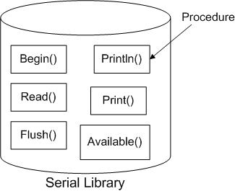
Serial.begin()
Serial is a library and begin() is a procedure of Serial Library.
Serial.begin() sets the data rate in bits per second for serial data transmission.
For communicating with the computer, use one of these rates: 300, 600, 1200, 2400, 4800, 9600, 14400, 19200, 28800, 38400, 57600, or 115200 (we will be using 9600).
Syntax:
Serial.begin(speed);
Eg: Serial.begin(9600);

Slide 13
Serial.print()
In many cases while using an Arduino, you will want to see the data being generated by the Arduino.
One common method of doing this is using the Serial. print() and println() from the Serial library to display information to your computer’s monitor.
Syntax:
Serial.print(val);
If we have to print text then we have to write:
Serial.print(“Hello World!!!!”);

Slide 14
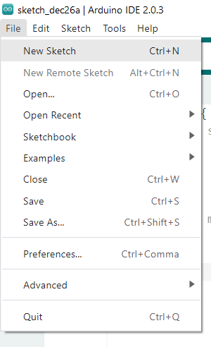
How to create a new project

Slide 15
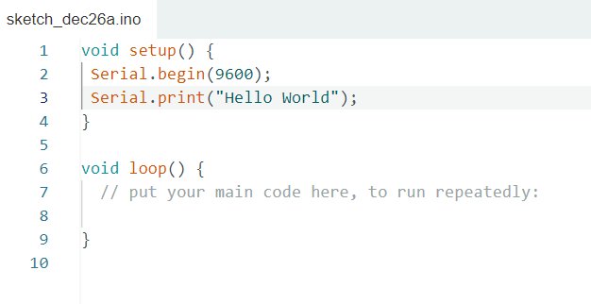
My First Program

Slide 16
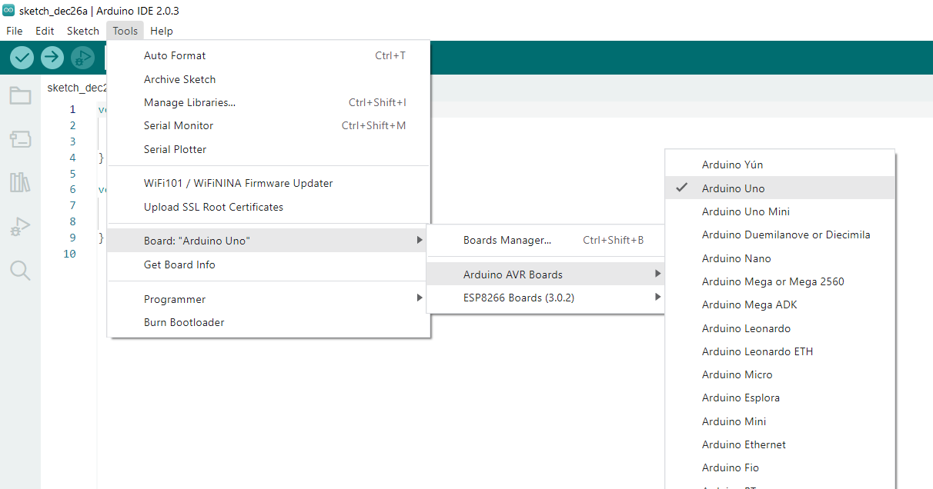
Instructions for uploading the code
Connect the USB Cable(One end to Computer and other end to Arduino)
We have to select the name of the board we are using. Go to → Tools → Board → Arduino Uno

Slide 17
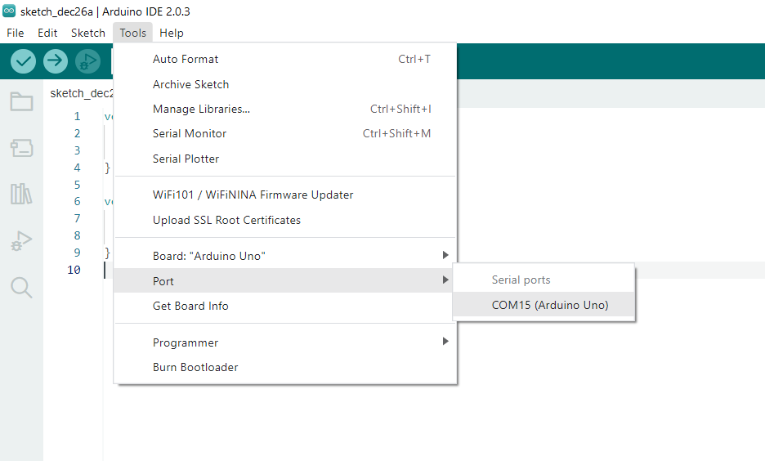
Select the Port. Go to Tools → Port → Select the COM port beside which its written (Arduino/Genuino Uno)

Slide 18
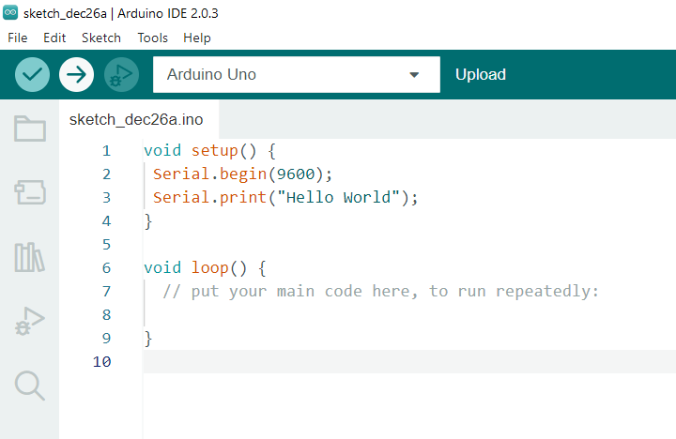
To upload the sketch, click on this upload option

Slide 19
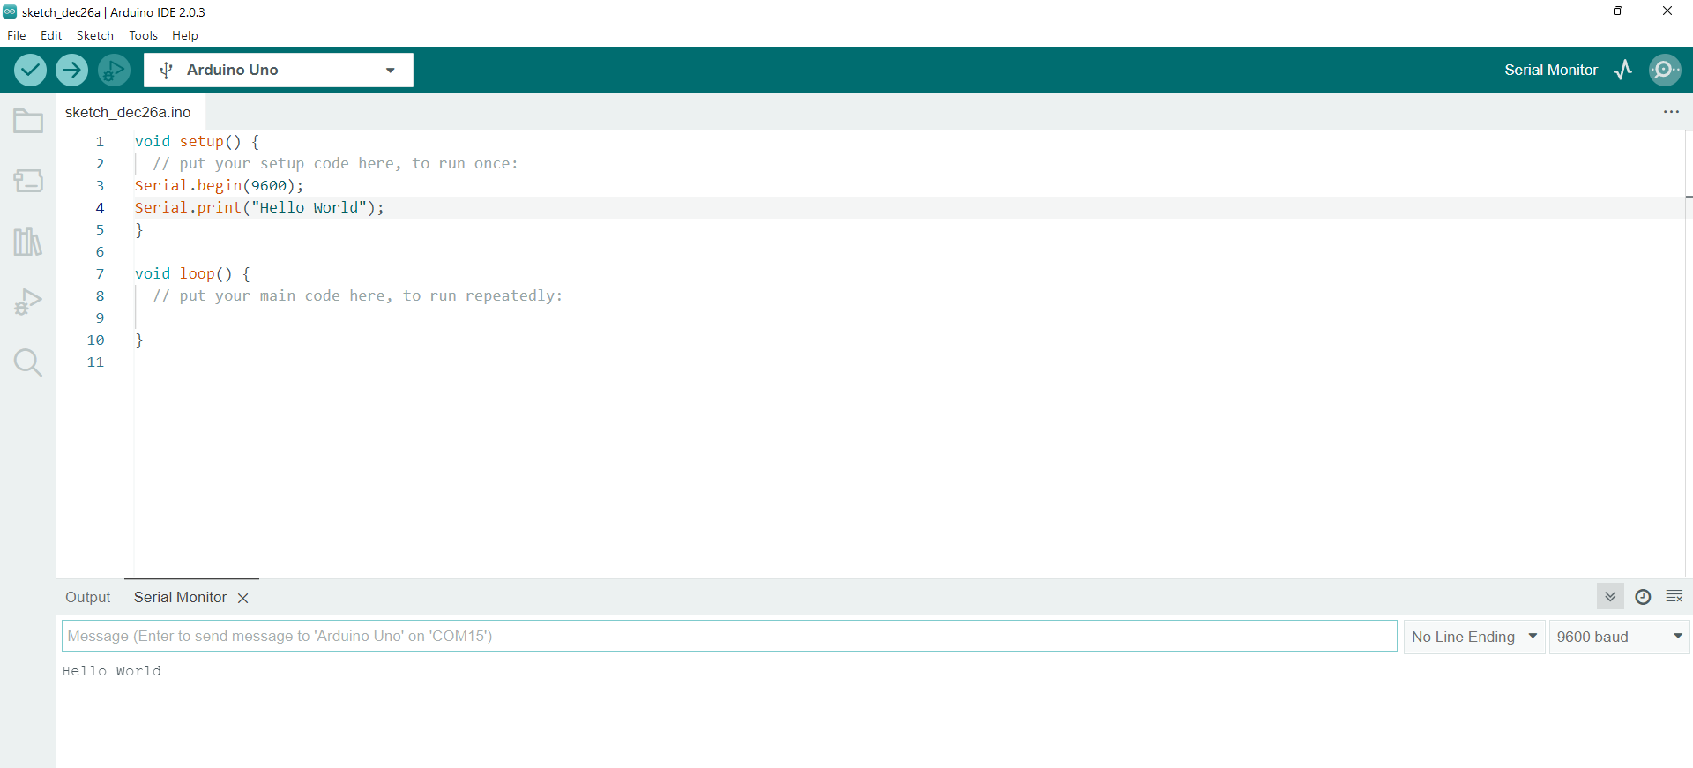
To check the output, click on the option of the serial monitor
FOR CHECKING OUTPUT ON SERIAL MONITOR

Slide 20
Delay()
Pauses the program for the amount of time (in milliseconds) specified as parameter. (There are 1000 milliseconds in a second.)
Syntax
delay(ms);
ms: the number of milliseconds to pause
Example : delay(2000);

Slide 21
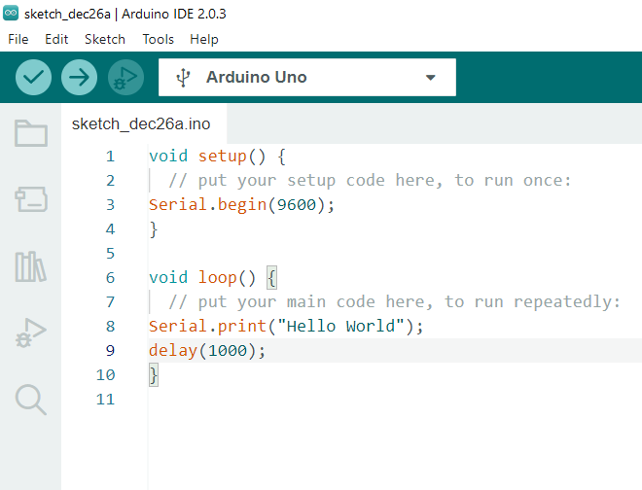
Code with delay

